Slide 1
CSR
Strategy
This project result has been funded with support from the European Commission. This communication reflects the views only of the author, and the Commission cannot be held responsible for any use which may be made of the information contained therein. Submission Number: 2021-1-ES02-KA220-YOU-000028609

Slide 2
Summary
Introduction
What Is Corporate Social Responsibility (CSR)?
Why CSR is crucial for companies?
What Is the Impact of CSR?
The internal and external benefits of incorporating CSR.
Which management practices help drive CSR?
Strengthening organizational capital and a culture of value
Responsible management education helps foster profitable outcomes.
Conclusion

Slide 3
Introduction
CSR Strategy
The corporate social responsibility (CSR) strategy is an initiative, into which the business sector incorporates social and environmental concerns. Therefore, the business sector can play a more responsible role in the world. Companies and funders use CSR strategy to design, implement and analyze their corporate social responsibility initiatives. It includes specific focus areas, program design, promotion and communication approaches, and evaluation procedures.

Slide 4
What Is Corporate Social Responsibility (CSR)?
The term corporate social responsibility (CSR) refers to practices and policies undertaken by corporations intended to have a positive influence on the world. The key idea behind CSR is for corporations to pursue other pro-social objectives, in addition to maximizing profits. Examples of common CSR objectives include minimizing environmental pollutions, promoting volunteerism among company employees, and donating to charity.

Slide 5
Why CSR is crucial for companies?
Many companies view CSR as an integral part of their brand image. Companies believe that customers will be more likely to do business with brands that they perceive to be more ethical. In this sense, CSR activities can be an important component in a company’s public relations. At the same time, some company founders are also motivated to engage in CSR due to their own beliefs

Slide 6
What Is the Impact of CSR?
The movement toward CSR has had an impact in several domains. For
example, many companies have taken steps to improve the environmental
sustainability of their operations, through installing renewable energy sources or purchasing carbon offsets. In managing supply chains, efforts have also been taken to eliminate reliance on unethical labor practices, such as child labor and slavery.

Slide 7
Although CSR programs have generally been most common among large
corporations, small businesses also participate in CSR through smaller-scale
programs, such as donating to local charities and sponsoring local events.
CSR is part of an organization’s broader responsibility to the society it
operates in.

Slide 8
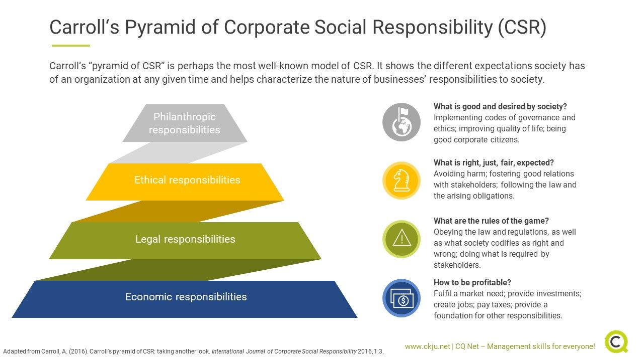
CSR has long held its place in management literature: In 1999, Carroll
coined the “Pyramid of Corporate Social Responsibility”. This pyramid
outlines organizational priorities and sees four distinct sets of
responsibilities that help characterize businesses and their responsibility to
the society they are part of. As shown in the image below (Carroll, 2016),
these priorities are economic, legal, ethical, and philanthropic.

Slide 9
The internal and external benefits of incorporating CSR.
Empirical studies on CSR shows that there are indeed benefits to acknowledging the top of Carroll’s pyramid and incorporating it into a broader strategy. Furthermore, companies witness lower employee turnover, higher reputation, and higher customer satisfaction.
CSR also leads to greater financial performance. It helps firms to attract higher quality employees and to operate at greater efficiency with lower costs. In addition, CSR can motivate employees, bring trust, morale and commitment. Therefore, CSR has been summarized as competitive business benefit.

Slide 10
From commercial perspective, CSR is considered a part of strategic plan. For instance, businesses want to improve reputations or to be competitive, CSR could be an assistant for getting intangible resources
and human resources. Furthermore, improving communication competences, management skills and enhancing corporate culture in businesses.

Slide 11
Which management practices help drive corporate social responsibility?
CSR can be integrated into parts of the organization and supplement goals of a company. It thus becomes part of “organizational capital” and spans operations, monitoring, targets, and incentives. To align profit and philanthropy in practice, organizations can take small steps to express their social responsibility into the overall mindset and organizational culture. This can help drive CSR in a consistent, determined, and all-encompassing manner and be a steppingstone for further steps.

Slide 12
Strengthening organizational capital and a culture of value.
Although organizational capital has been considered as playing a subtle role in company outcomes, having strong and good organizational capital can be a competitive trait that is not easy to be imitated, replaced, or transferred.
Based on this idea, fostering a culture of value and commitment that underpins management, operations, incentives and monitoring activities alike is likely to boost productivity, and commitment, and help create a sustainable mindset.
A code of ethics can provide guidance for the organization. Thus, it can reduce the risk of irresponsible behaviour.

Slide 13
Responsible management education helps foster profitable outcomes.
Ethical training can be conceived as an accelerator to manage organizations socially and ethically. Business schools had the integration of “responsible management” into their curriculum to deviate from the competition and profit-driven management. Additionally, having management education leads to improved social actions, and hence affect social outcomes.
Hence, leaders should take a proactive approach towards getting informed about practices of leadership that help foster sustainable and authentic outcomes for employees, stakeholders, and leadership alike.

Slide 14
Reporting and transparency help identify risks and opportunities.
Practising CSR and a sustainable strategy also means communicating. CSR are a vital
benchmark for taking responsibility and showcase economic data, as well as
information about the environment and social field.
Using CSR can help boost reputation, and authenticity and be a key component of a business’ stakeholder strategy. Research finds that the most successful forms of CSR reporting generally include an interplay of three broad themes:
vision and goals,
management approach, and
performance indicators.
They can help bring a systemic approach to management and help to identify risks and opportunities for improvement (Moravcikova et al., 2015).

Slide 15
Creating shared value and establishing a shared vision with society can
be part of any change-management strategy.
The methods above are a good starting point for embedding CSR into organizations and committing to socially responsible practices. This can be part of any change-management strategy and help organizations succeed on many levels
A way to view CSR in company practices is to understand it as creating shared value. Although firms should inherently not to act as charities, they can take on practices (using their knowledge, resources and tools) to help create a shared vision with the society.

Slide 16
Conclusion
CSR Strategy
CSR is more than just a business trend. Businesses that want to stay relevant to new generations and who want to help people around the world will benefit from embracing CSR.

Slide 17
Thank you!!!

